Slide 1
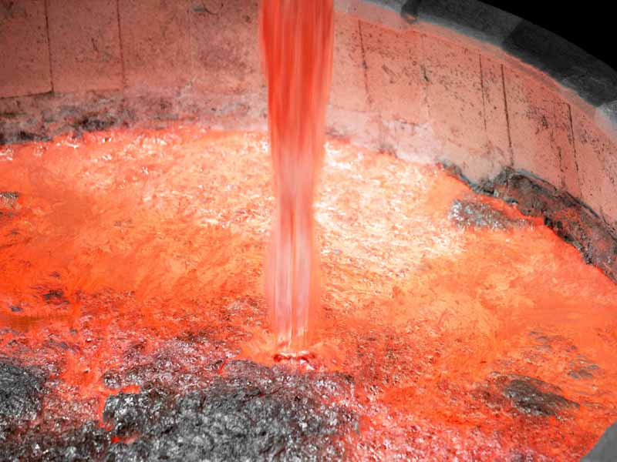
ELIT YATIRIM
BAKU

Slide 2
ABOUT COMPANY
Elit Yatirim Ltd was established in 1995 and started its operations with full capacity in 1996 with follows working principles
Vision:
Making a difference with the products and services which we offer, becoming the industry leader on the national scale and being a well known brand in international markets.
Mission:
Continuous development of our quality of sense with our products and services to provide an efficient use of energy and materials for more environment friendly production.
Owner of Company : Mr. Mehmet Dortok

Slide 3
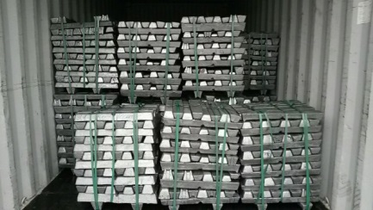
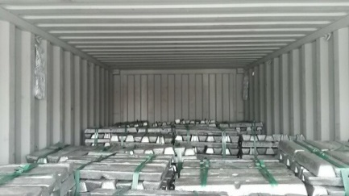
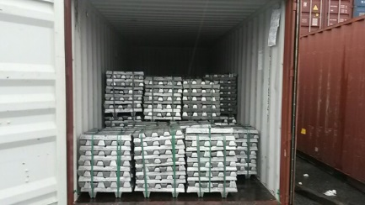
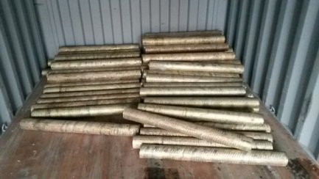
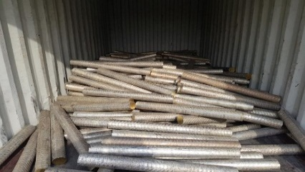
PRODUCTS
ALUMINIUM ALLOY INGOT
BRASS BILLET

Slide 4
MARKETS FOR PRODUCTS
ALUMINIUM ALLOY INGOT
JSC UzAuto Motors Powertrain(Uzbekistan) (A333)
JV «UZAUTO-INZI» LLC(Uzbekistan) (ADC10 & ADC12 )
Honda Trading (Japan) (ADC12 / AK5M2)
Hoei Shokai Co.Ltd (Japan) (AK5M2)
Italy ( Rag-All Spa) (EN 46100)
Tradmet Ltd (UK) (EN46100 / AK5M2 / DIN 226)
Ugur Metal Ltd (Turkey) (DIN 226 / EN 44100)
Kaya-Pen Ltd (Turkey) (EN 46100)
Sahinler Aluminium (Turkey) (DIN 226 / AL 97.0%)
Assan Alüminyum (Turkey) (AL 99.70%)
BRASS BILLET
Tradmet Ltd (UK) & Different companies in China
STAINLESS JUMBO BLOCK
Tradmet Ltd(UK) & Different yards in Holland

Slide 5
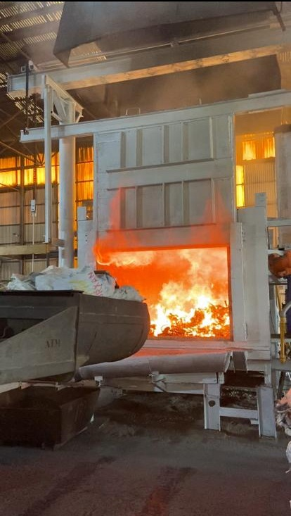
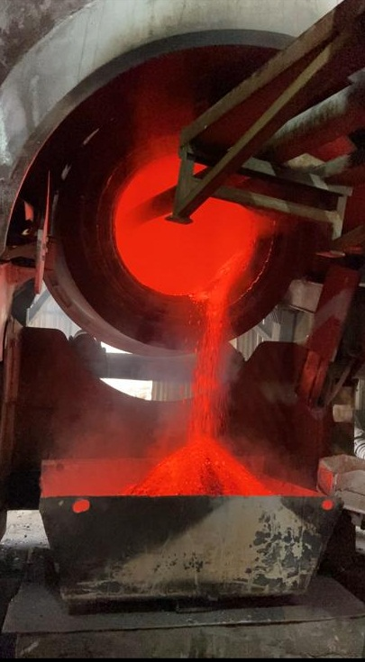
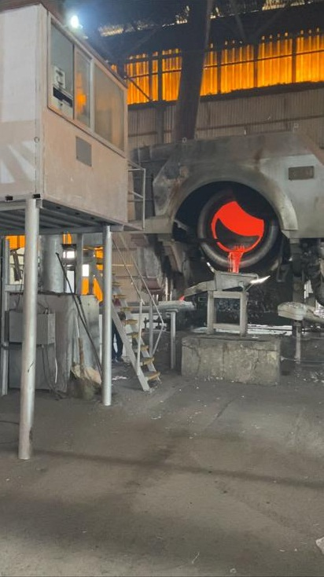
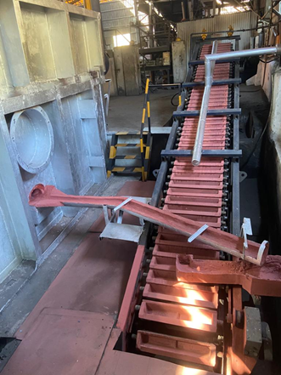
FURNACES FOR ALUMINIUM PRODUCTION
ROTARY FURNACE
Liquid Metal Capacity : 4.000 Kgs.
Production Capacity : 300 Mt/Month

Slide 6
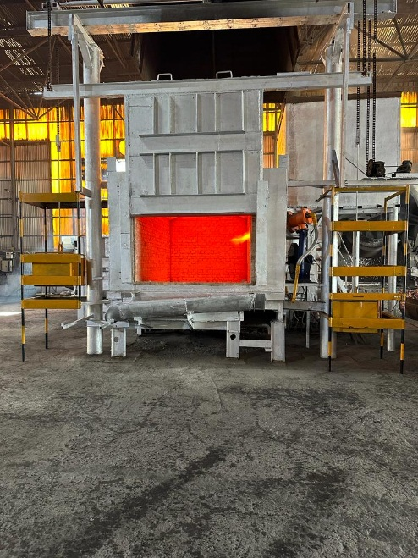
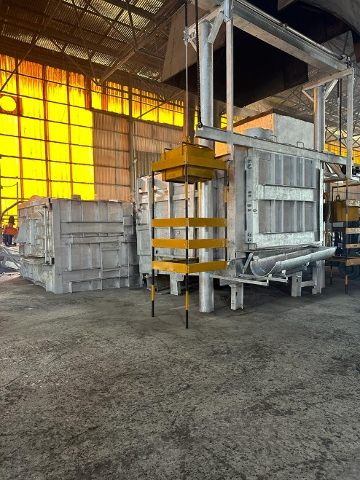
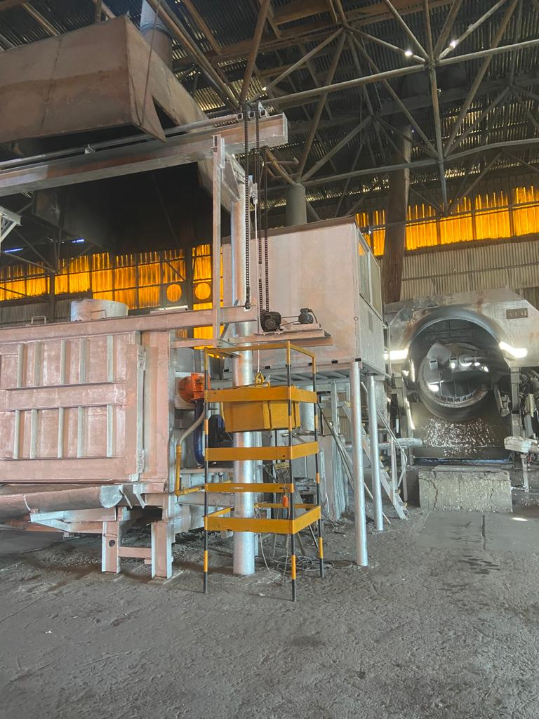
FURNACES FOR ALUMINIUM PRODUCTION
3 REVERBERATORY FURNACES
These furnaces have a melting and holding unit.
Holding Furnace Liquid Metal Capacity : 10.000 Kgs / 15.000 Kgs / 22.000 Kgs
Production Capacity : 1.200 Mt/month .

Slide 7
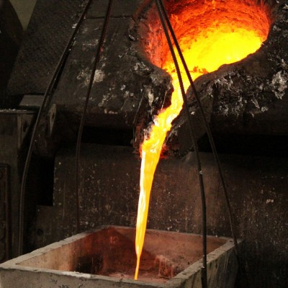
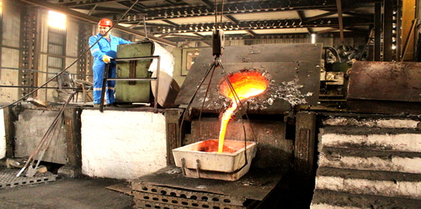
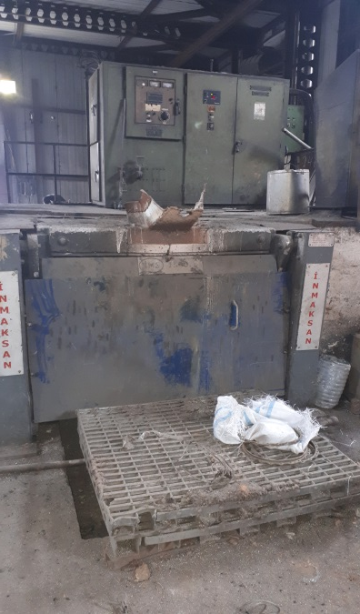
FURNACES FOR ALUMINIUM PRODUCTION
INDUCTION FURNACE
Liquid Metal Capacity : 1.000Kgs
Production Capacity : 200 Mt/Month
It is used for production of master alloy which are AlSi / AlCu / AlMn etc. For other furnaces.

Slide 8
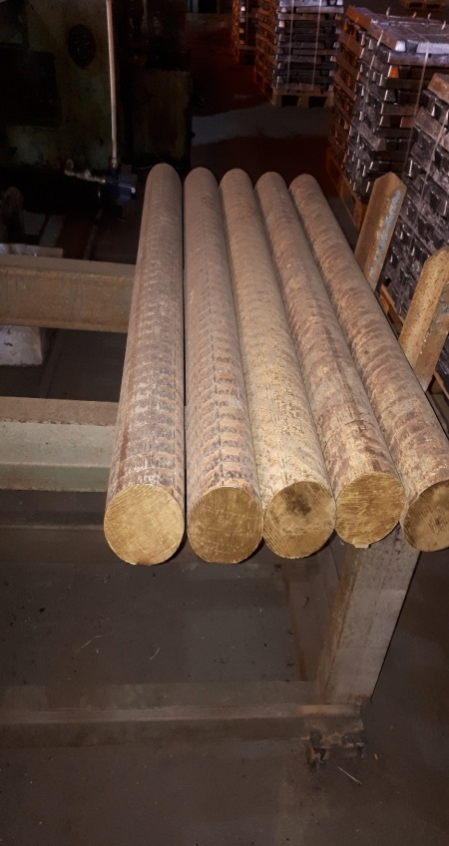
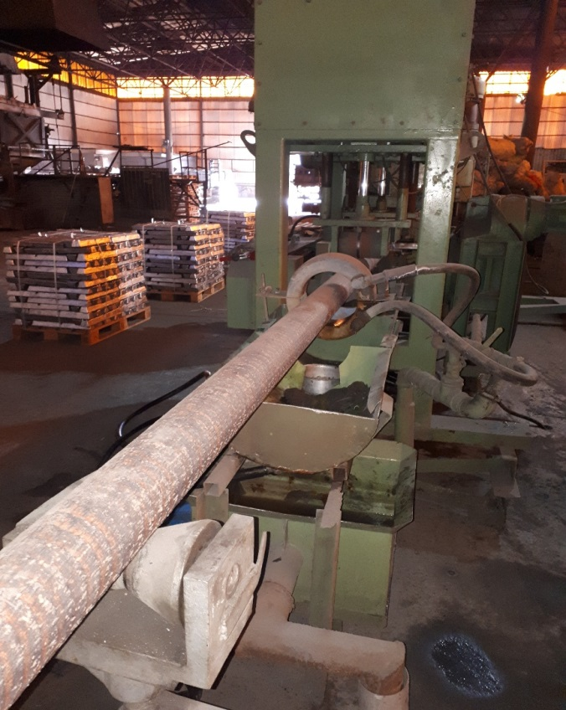
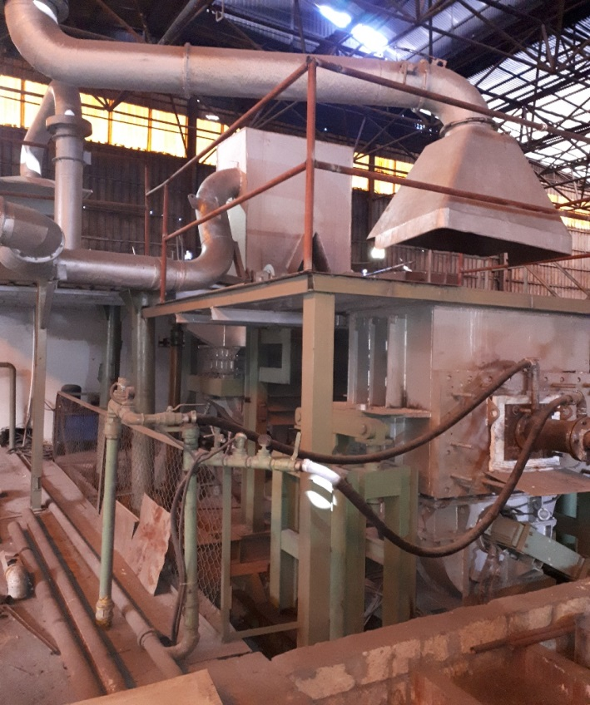
BRASS BILLET PRODUCTION UNIT
Capacity : 450 Mt/Month

Slide 9
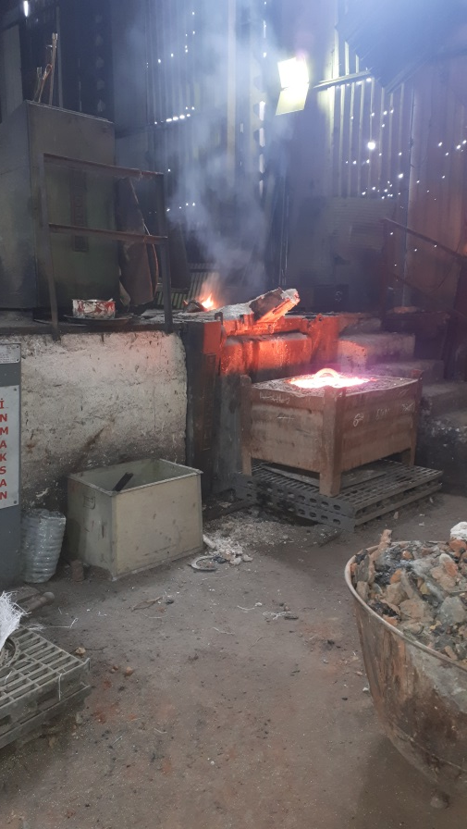
STAINLESS PRODUCTION INDUCTION FURNACE
Liquid Metal Capacity : 500 Kgs
Production Capacity : 200 Mt/Month

Slide 10
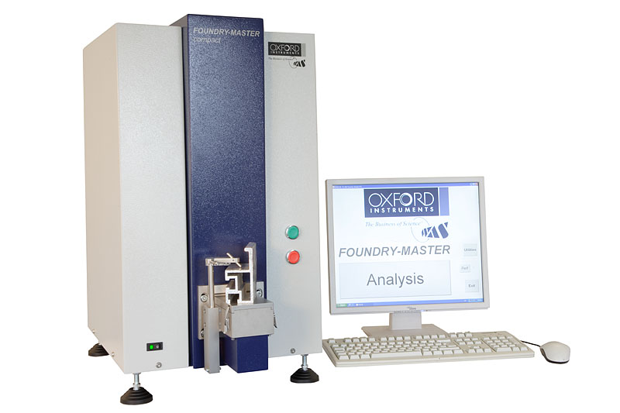
LABORATORY
SPECTROMETER- OXFORD INSTRUMENTS

Slide 11
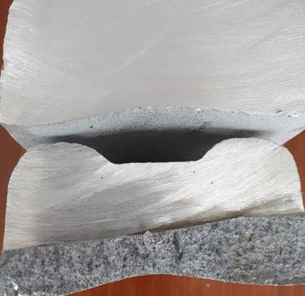
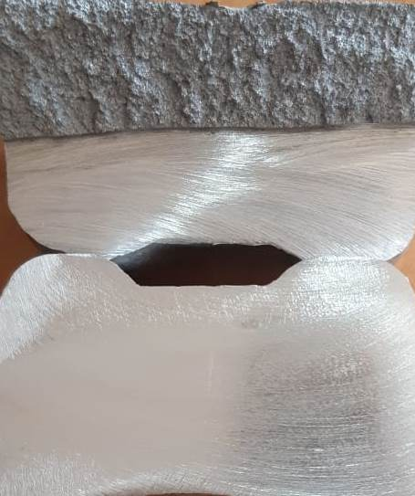
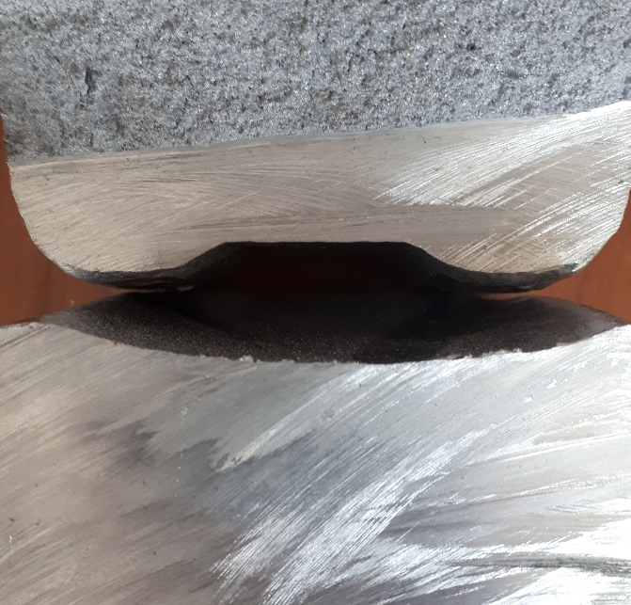
LABORATORY
We can do porosity and macrostructure test in our laboratory.

Slide 12
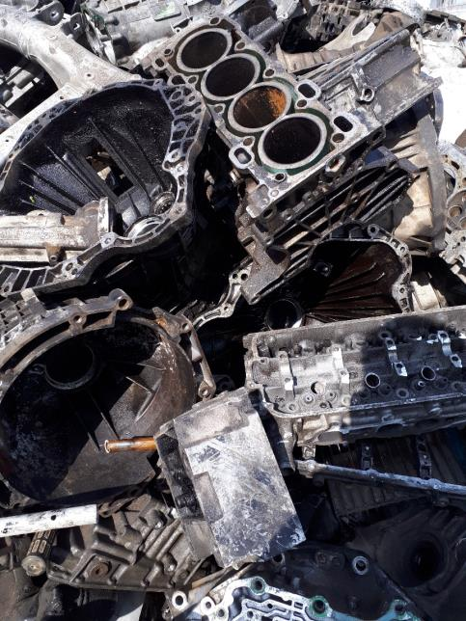
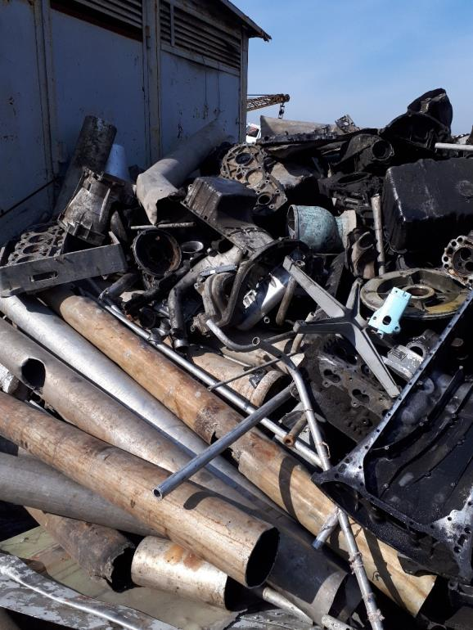
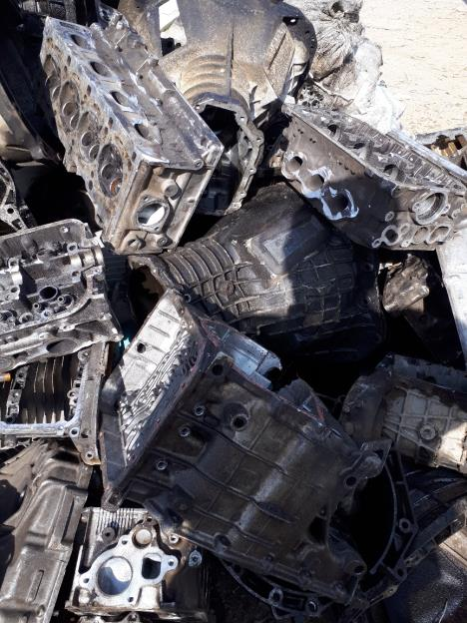
SCRAP TYPES
ISRI - TENSE

Slide 13
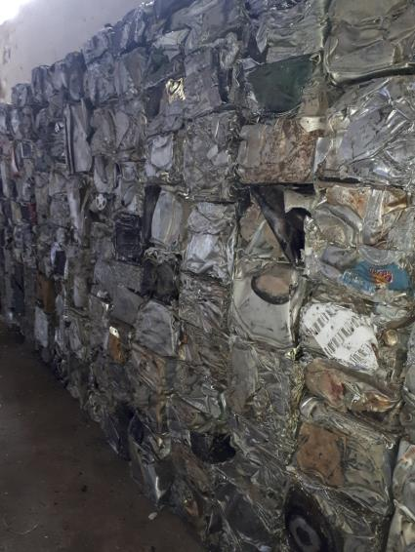
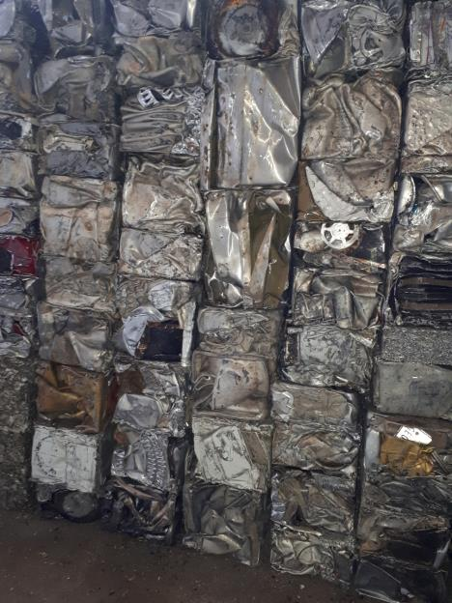
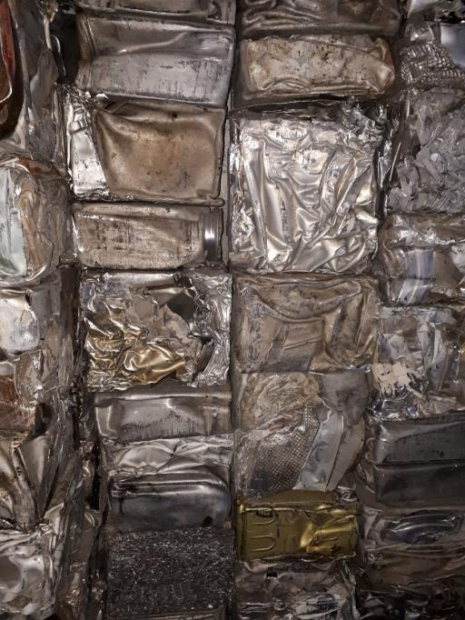
ISRI TAINT-TABOR

Slide 14
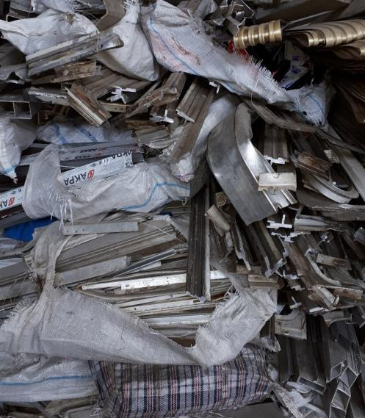
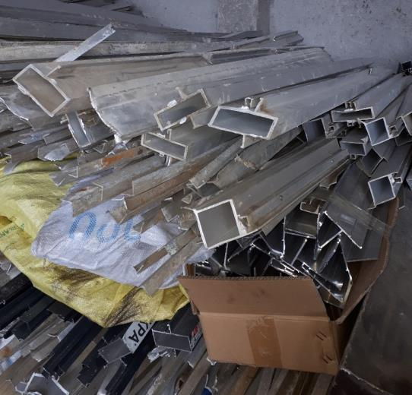
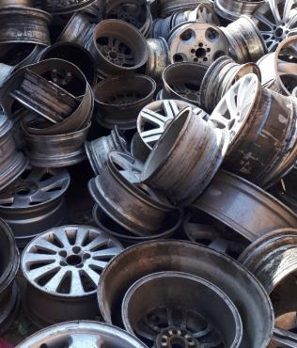
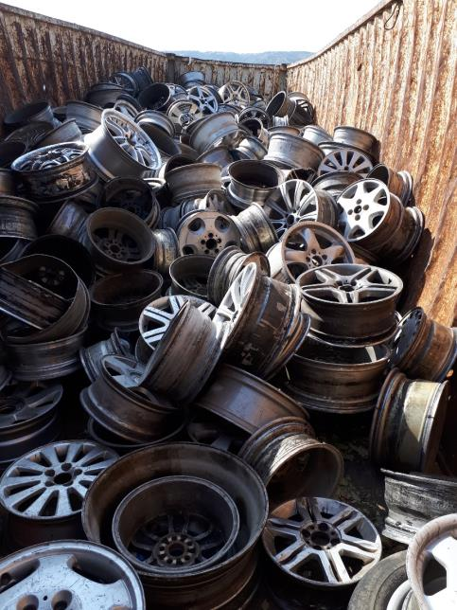
ISRI- TATA
ISRI- TROMA

Slide 15
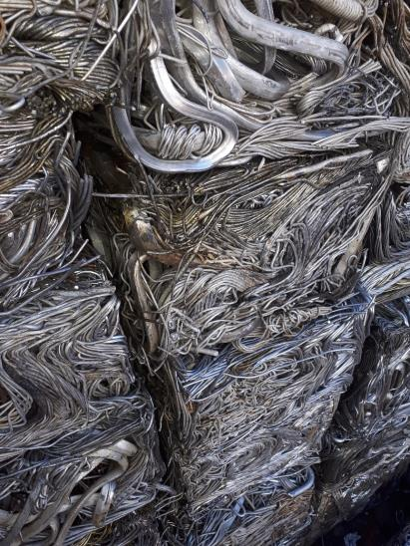
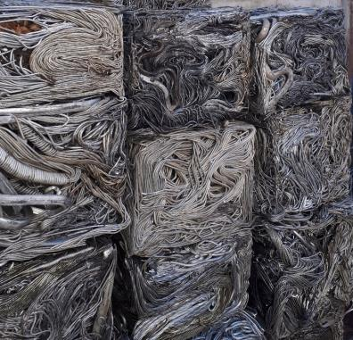
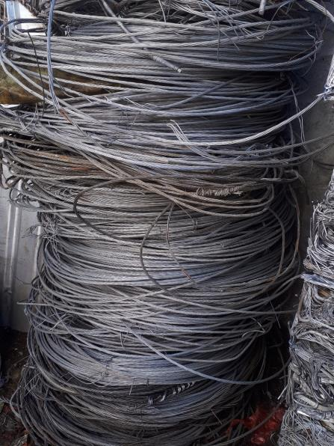
ISRI-TASTE

Slide 16
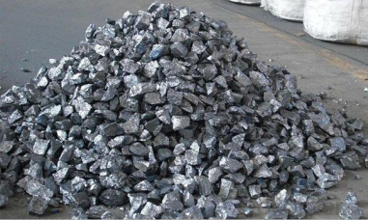
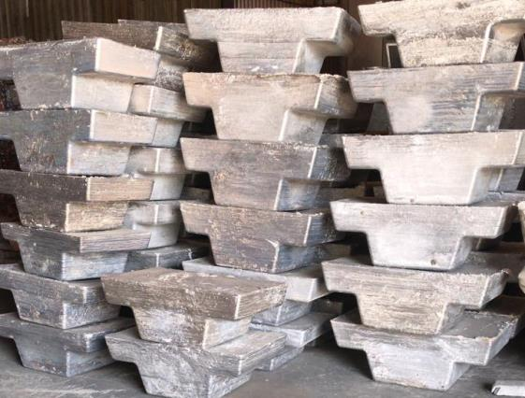
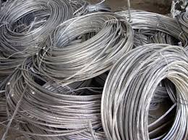
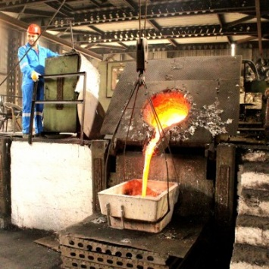
MASTER ALLOY PREPARATION FOR PRODUCTION

Slide 17
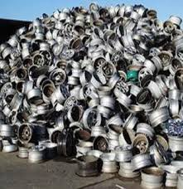
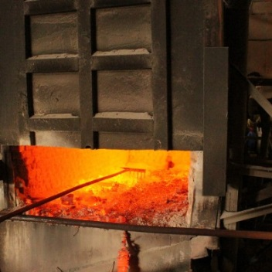
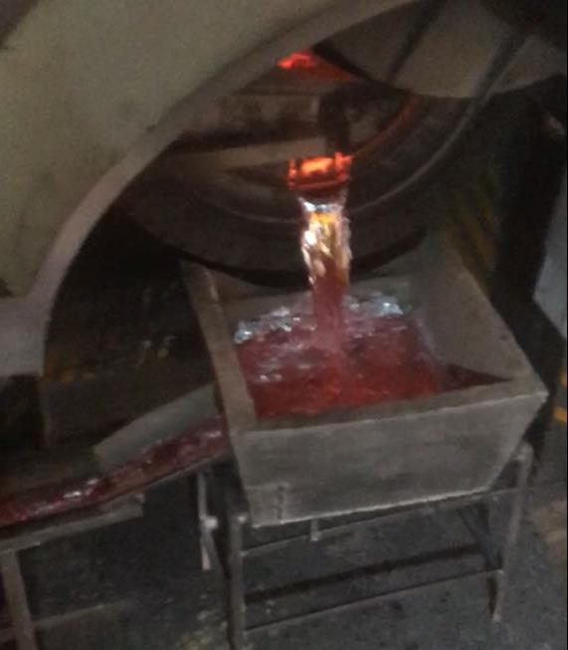
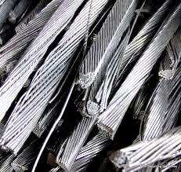
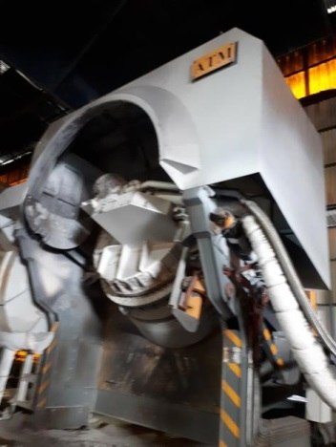
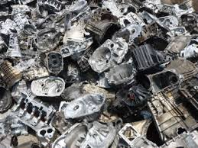
MELTING PROCESS
me
MELTING

Slide 18
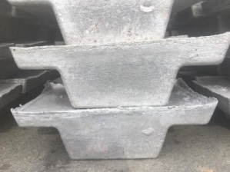
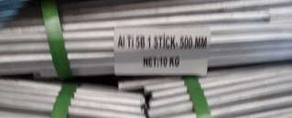
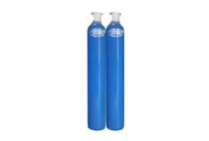
MELTING PROCESS
ARGON SILICON METAL
AS MASTER ALLOY
LIQUID METAL CASTING MACHINE PACKING
IN TO HOLDING
FURNACE
COPPER SCRAP
QUALITY CONTROL
CERAMIC FILTER

Slide 19
INGOT DIMENSIONS

Slide 20
INGOT PICTURE

Slide 21
PACKING-BUNDLE
BUNDLES
DIMENSIONS : 650 X 650X 600 MM
WEIGHT OF INGOT: 7 KGS ( +/- 0.5 KGS)
WEIGHT OF BUNDLES : 500 KGS ( +/- 30 KGS)

Slide 22
PACKING-PALLET

Slide 23
QUALITY CERTIFICATE

Slide 24
DEGASSING
2 TYPES DEGASSING CAN BE DONE FOR ALUMINIUM. THESE ARE «STATIC LENS» & «ROTARY IMPELLER»
MOSTLY ROTARY TYPE DEGASSING IS USED FOR END PRODUCT PRODUCTION. FOR SECONDARY ALUMINIUM ALLOY INGOT PRODUCTION LENS TYPE DEGASSING IS MORE EFFICIENT BECAUSE ALSO IT HELPS DISOLVE AND HOMOGENEOUS DISTRIBUTION IN FURNACE OF ADDITIVES.
WE INSERT ARGON GASES IN FURNACE WITH LENS BEFORE START POURING. ALSO WE ARE DOING SAME PROSES AFTER ADD EVERY MASTER ALLOY i.e. AlTiB.
WE DON’T PRODUCE A333 DIRECTLY FROM SCRAP. FOR CONTROL OF Fe% and DROSS CONTENT OF MATERIAL WE PRODUCE INGOT AS MASTER ALLOY WHICH HAS ENOUGH SILICON & MANGANESE & COPPER THEN WE USE THESE INGOTS FOR SECOND STEP WHICH WE PRODUCE EXACT A333 ALLOY. WE USE ARGON GASES AS DEGASSER WITH STATIC LENS ON BOTH STEP. ALSO ON EACH STEP WE SEPERATE DROS FROM FURNACE AND POUR WITH CERAMIC FILTER. AFTER SECOND MELTING WE ADD ALTIB & ALSR . WHEN COMPARE OUR MATERIAL WITH OTHER PRODUCER YOU HAVE SOME ADVANTAGES. THESE ARE:
DROS CONTENT IN INGOT IS VERY LOW SO YIELD OF YOUR PRODUCTION WILL BE HIGH.
WE USE ARGON ON MANY STEP AND LONGER TIME THEN ROTARY TYPE SO YOU CAN’T SEE POROSITY AND ALSO VERY CLEAN , FINE AND HOMOGENEOUS MACROSTRUCTURE.

Slide 25
FE % IN OUR PRODUCTION
Fe % MAX 0.50% IN GM STANDART BUT TARGET 0.42 % SO OUR TARGET MUST BE REACH GM REQUIREMENT
For 5mt trial batch Fe % was between 0.44-0.46 %.
We can produce almost wıthın thıs range wıthout changıng our process or raw materıals but we know Fe% ıs very ımportant for GM
We are workıng on thıs ıtem and only for ımprove qualıty WHICH MEANS DECREASE FE% we bought new machıne whıch ıs crusher & SEPERATOR of alumınıum CABLE. PICTURES OF THIS MACHINE ARE ON SLIDE 27.
ALUMINIUM WIRE IS PURE ALLOY SO FE CONTENT IS VERY LOW.
InstallIng OF THIS MACHINE ıs fınıshed and we started test productıon ın november. For new orders we can use more pure type raw materıal from product of thıs machıne whıch means we can get better result for Fe% to reach target of GM specIfIcatIon.
Also FOR STABILITY OF QUALITY we lısted scrap types whıch we can only use for GM A333 and FOCUSED BUY THESE FROM MARKET. WE ARE holdıng these scraps on dıfferent area ın our plant. IT HELPS US FOR strıckly control analysıs of materIal.
we are doıng calIbratIon OF SPECTROMETER everyday 2 tımes for A333 productıon INSTEAD OF 1 and also checkıng stabılıty of spectrometer wıth standart samples EVERY DAY.

Slide 26
ALUMINIUM WIRE CRUSHER
PURE ALUMINIUM CABLE

